Slide 1

Mainstreaming Slide Deck

Slide 2

What Is Mainstreaming?
In a “mainstreaming” genetic testing pathway, pre-test genetic counselling is performed by non-genetic healthcare professionals, thereby making genetic testing more accessible to all eligible patients who might benefit from it
Why Use Mainstreaming?
Increase accessibility to genetic testing and specific cancer treatments
Obtain genetic results more rapidly
Enhance efficient use of healthcare resources

Slide 3
Who Is Eligible?
Personal history of:
Epithelial ovarian cancer
Breast cancer (≤35 years, triple negative ≤60 years)
Metastatic or high-risk prostate cancer
Pancreatic adenocarcinoma
NOTE: Specific criteria may vary by jurisdiction

Slide 4
Justification
Principles to consider in the decision to mainstream a patient:
Patient is eligible for hereditary cancer testing based on their own personal history of cancer, regardless of family history
Results of hereditary cancer testing may impact surgical, radiation and/or systemic treatment planning, requiring an expedited turnaround time
Patient has a poor prognosis and may not survive to attend a cancer genetics pre-test counselling appointment
Mainstreaming Toolkit. Implementation Guide for Mainstreaming Hereditary Cancer Testing. September 14, 2021 (Cancer Care Ontario).

Slide 5
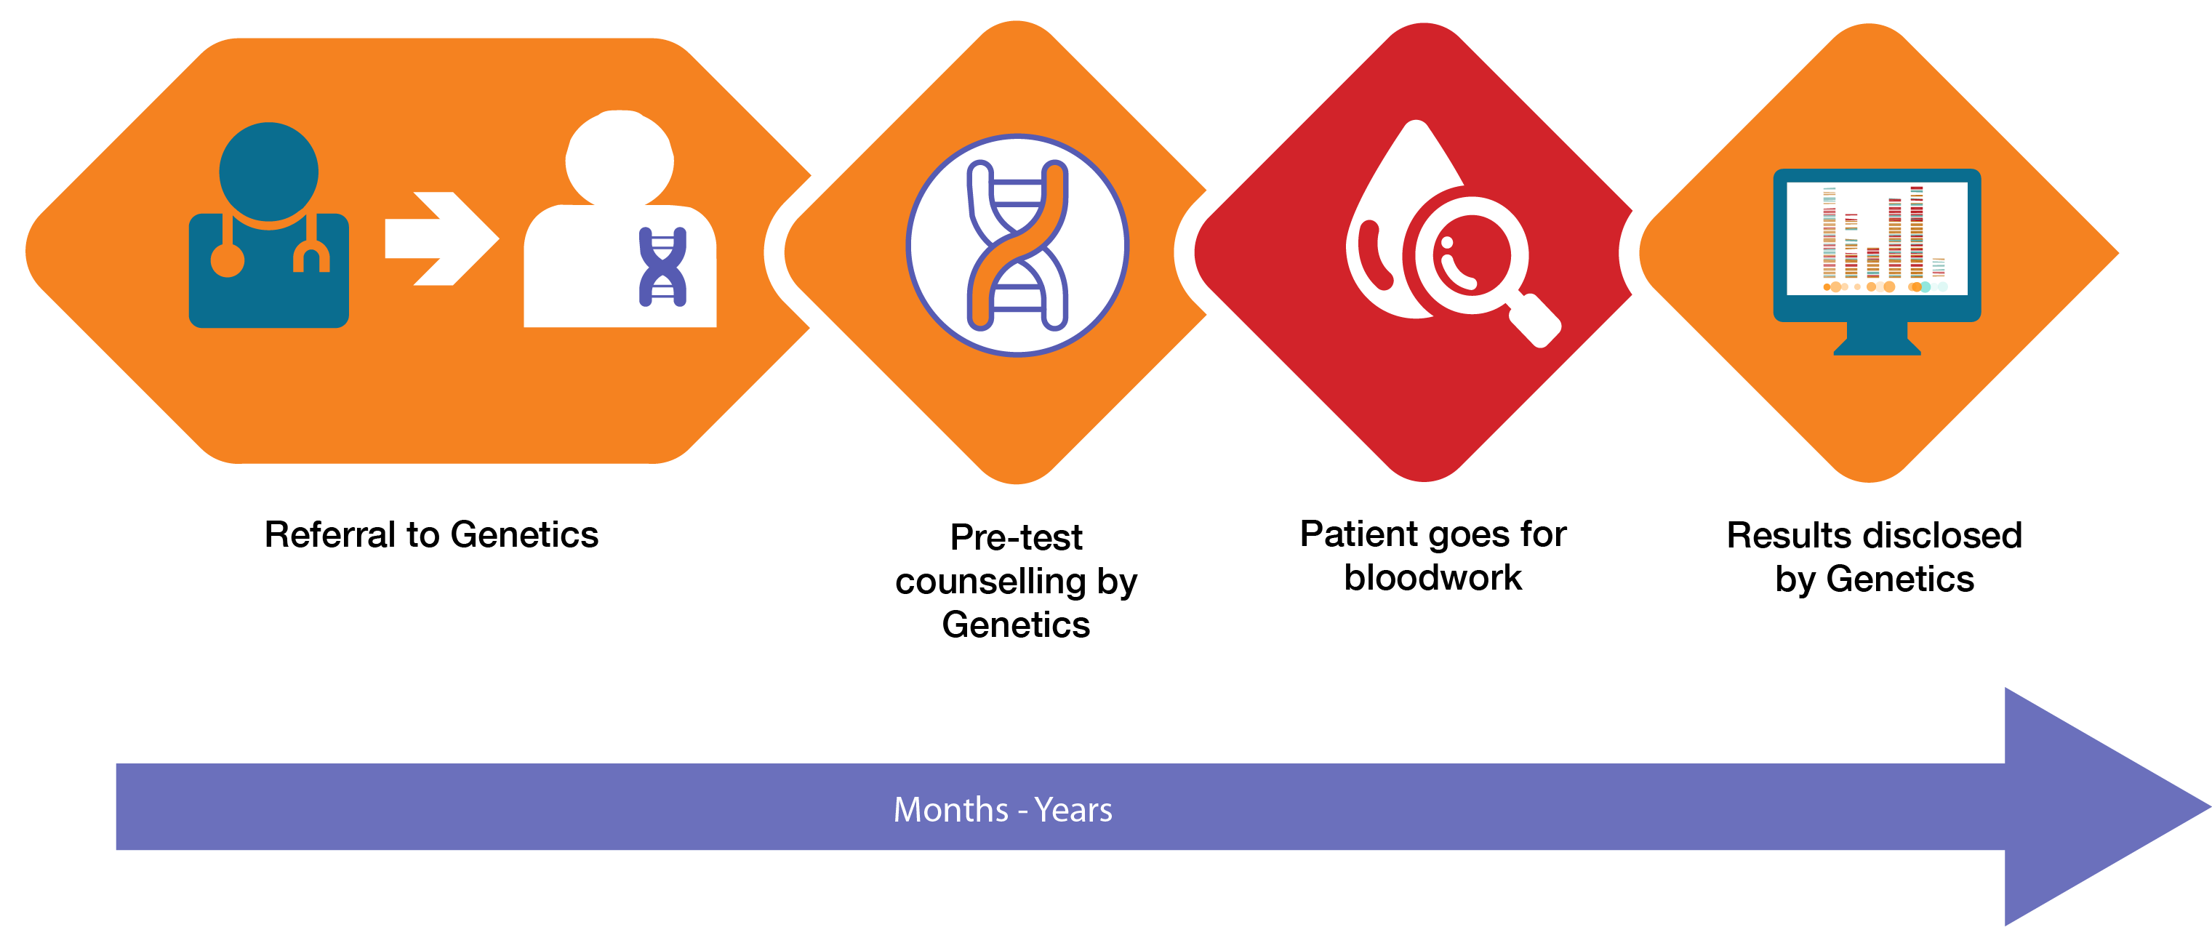
Traditional Genetic Testing Pathway

Slide 6
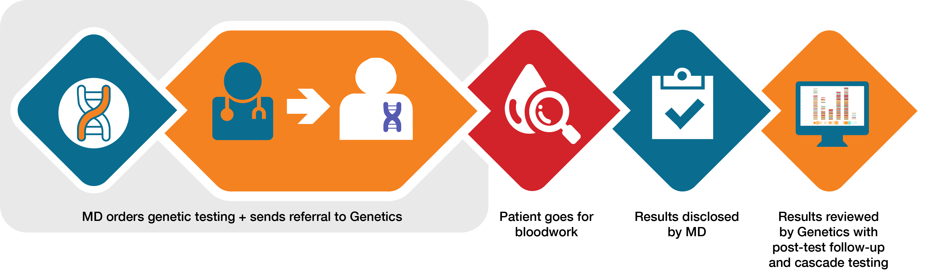
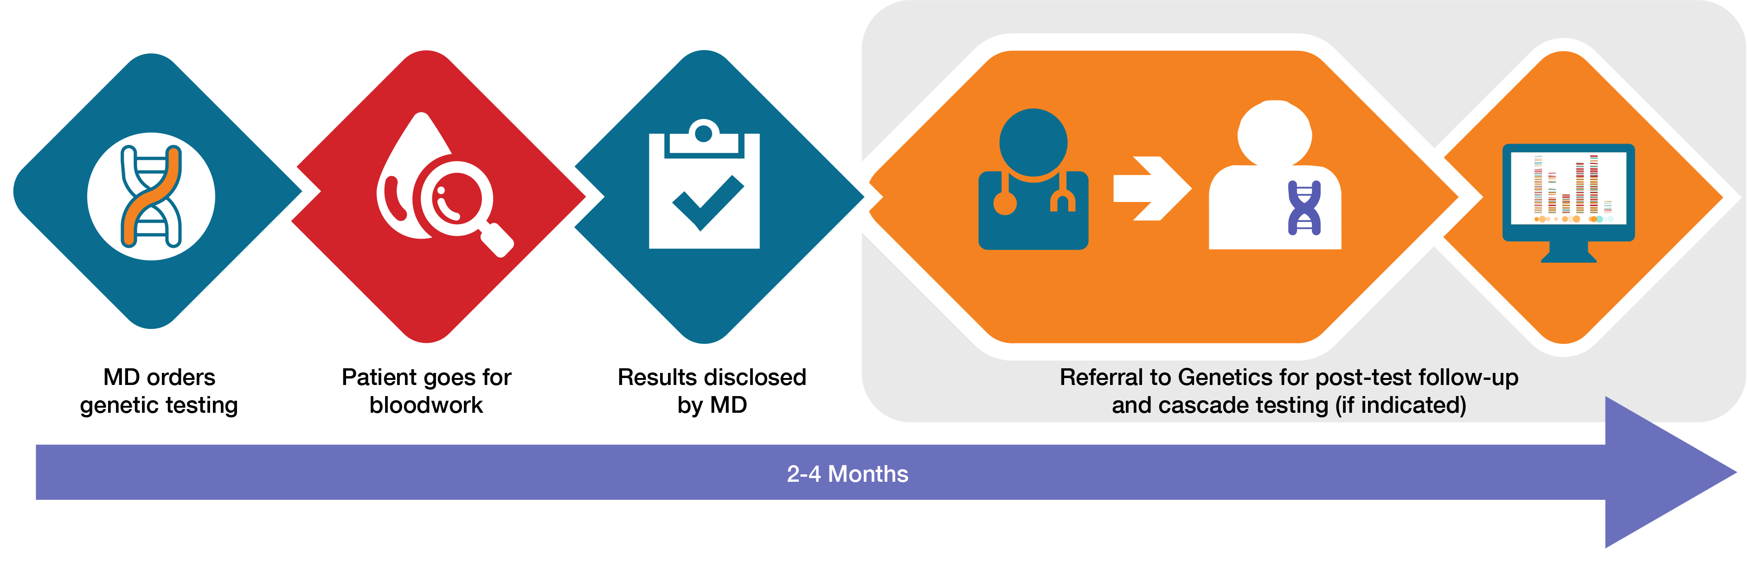
Mainstreaming Pathway Options*
OPTION 1
OPTION 2
* Variable pathways possible depending on the clinic (i.e. positives/VUS only referred vs. all patients).

Slide 7
Key Discussion Points With Patients
A genetic test is a blood (or saliva) test to see if your patient’s cancer is hereditary
Genetic test results may determine additional primary cancer risks for your patient
Genetic test results may guide the treatment of your patient’s cancer (i.e. different surgical options or chemotherapy)
Genetic test results may have implications for cancer risk in your patient’s relatives
Genetic test results are sometimes uncertain (i.e. unknown if a variant is truly associated with why your patient developed cancer)
Genetic information is protected by the Genetic Non-Discrimination Act
(GNDA July 2020)

Slide 8



Genetic Testing Outcomes
POSITIVE: Pathogenic variant (mutation) detected
Explains why your patient developed cancer and means that they might have an increased risk to develop other types of cancer
NEGATIVE: No variants detected
This does not necessarily exclude an underlying hereditary predisposition
VUS: Variant of uncertain clinical significance detected
Unable to confirm whether or not this change is linked to why your patient developed cancer
VUS results may be better understood or reclassified in the future

Slide 9
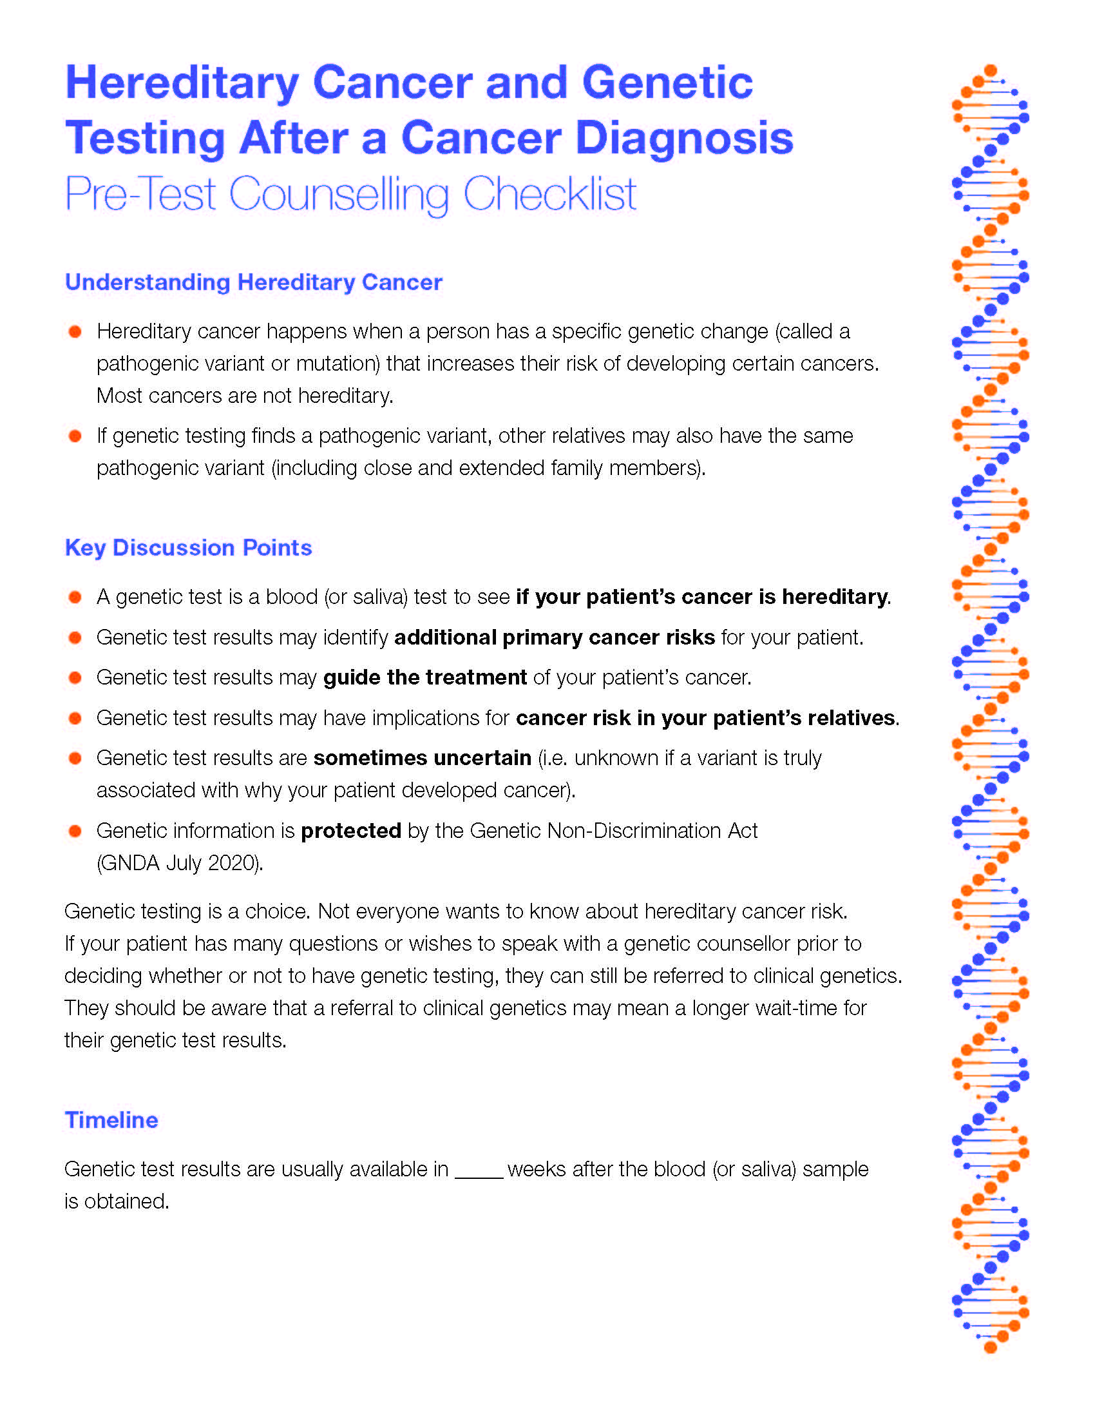
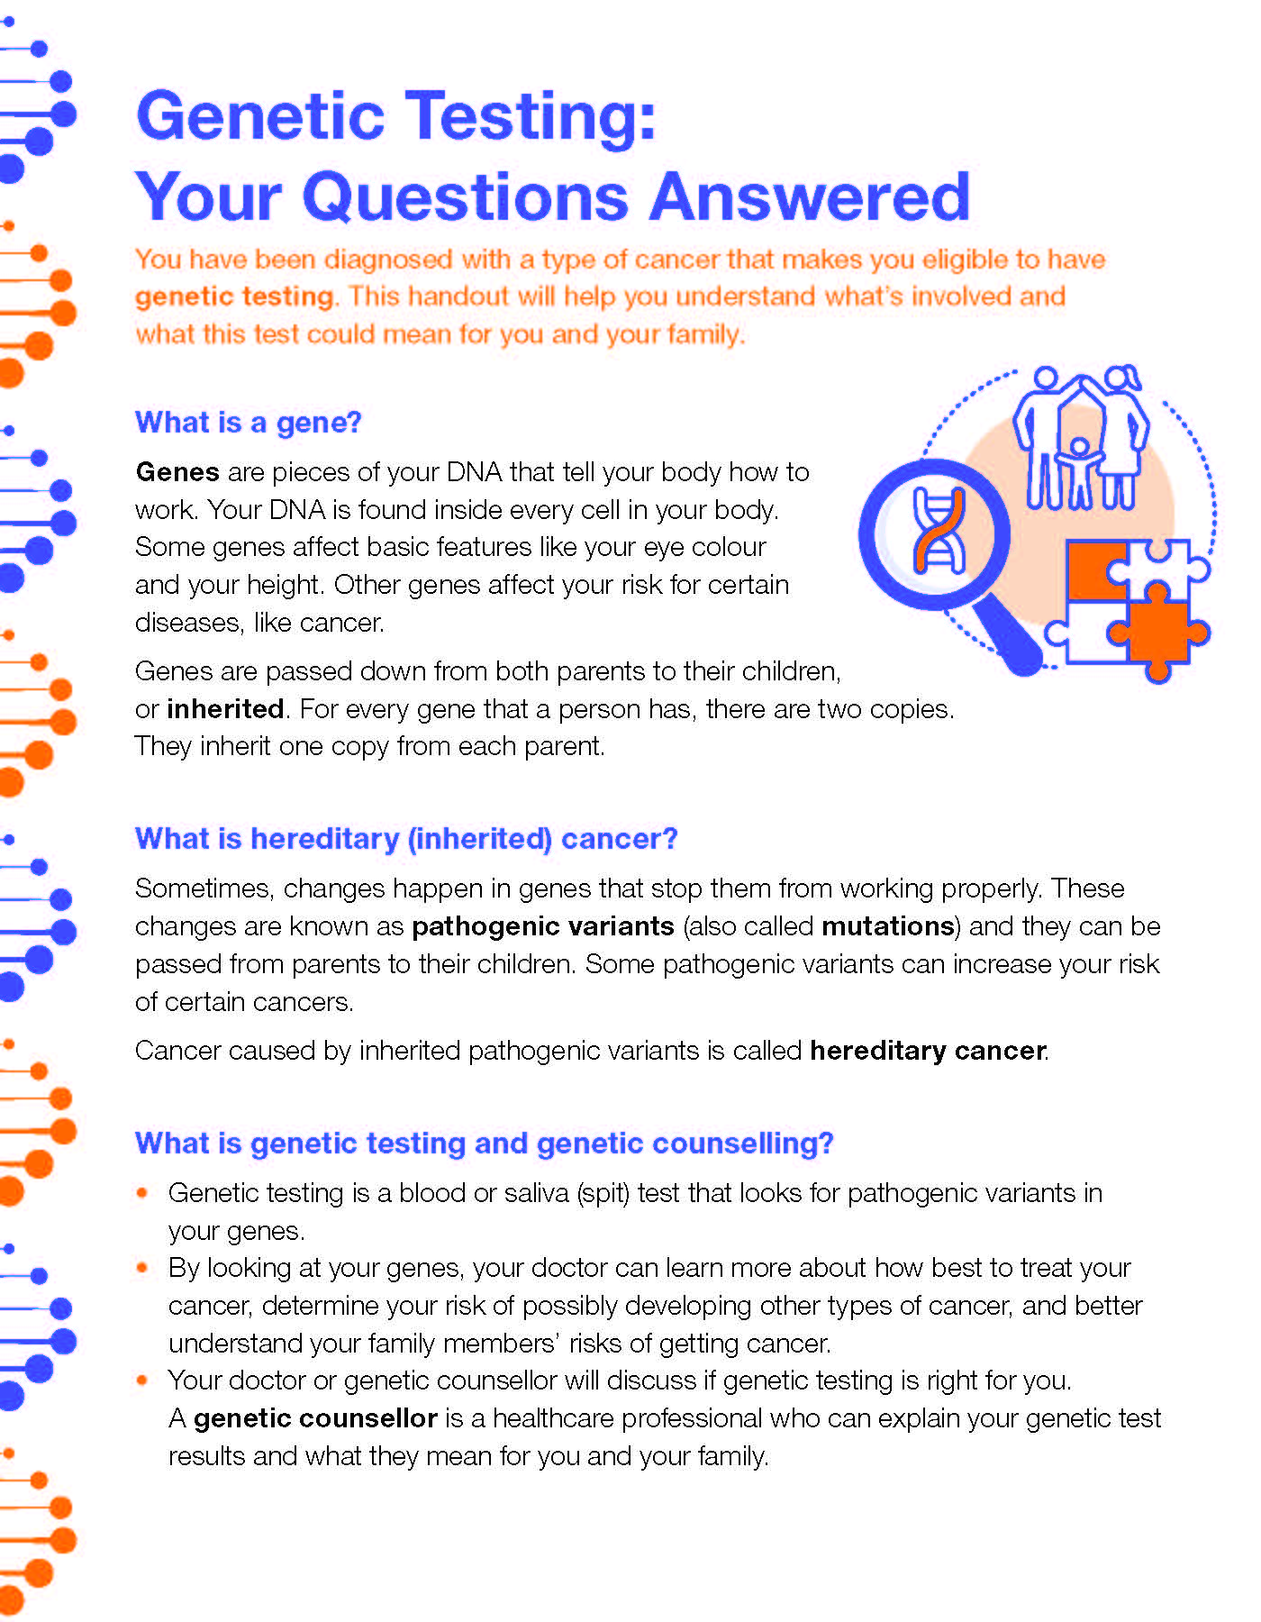
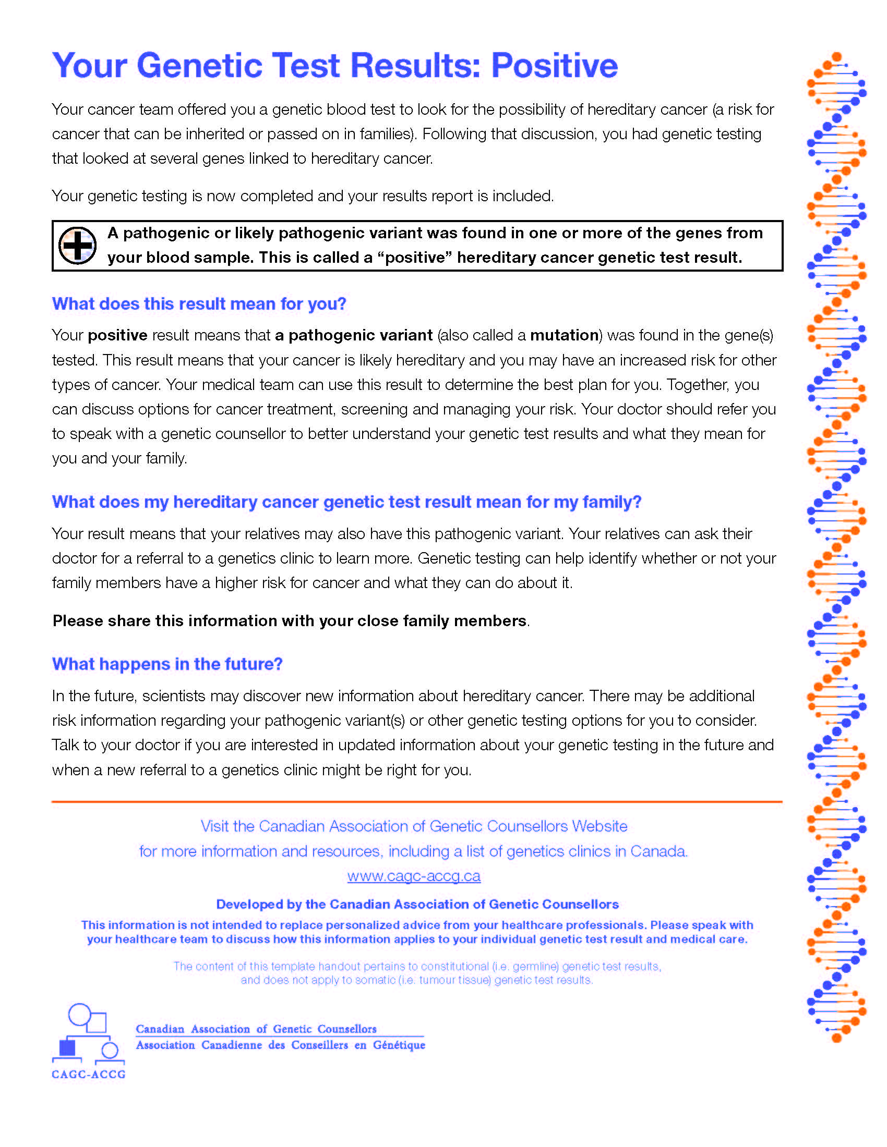

CAGC Mainstreaming Resources
Clinician Checklist
Patient Handout
Patient Results Letters
Patient Video

Slide 10

How To Order Genetic Testing
Slide for local instructions and requisition (depending on jurisdiction)

Slide 11

Genetic Testing Is A Choice
Not everyone wants to know about hereditary cancer risk
If your patient has many questions or wishes to speak with a genetic counsellor prior to deciding whether or not to have genetic testing, they can still be referred to clinical genetics
They should be aware that there may be a wait-time for an appointment depending on the jurisdiction

Slide 12
Value Of Interdisciplinary Teamwork: Find Your Champions!
Genetic Counsellors:
Provide genetic expertise
Assist in communications with both healthcare providers and patients
Manage family genetic testing when a pathogenic variant is found
Refer at risk family members to appropriate specialists for surveillance and prevention options
Oncology Specialists:
Initiate genetic testing
Use genetic information (as appropriate) in their patient’s care
Refer patients to genetics for further information (if needed)
Offer input on new cancer treatment options as they evolve

Slide 13
Next Steps
Your local contact for mainstreaming is:

Slide 14


